Slide 1
Welcome to our class

Slide 2
Describe the following pictures and answer the questions

Slide 3
Excited and energetic before the flight
Exhausted after travelling and working for long hours
1
2

Slide 4
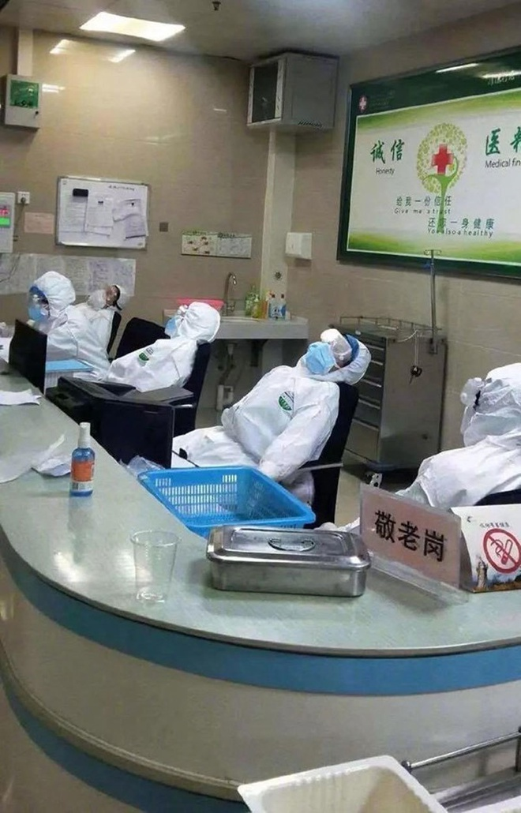
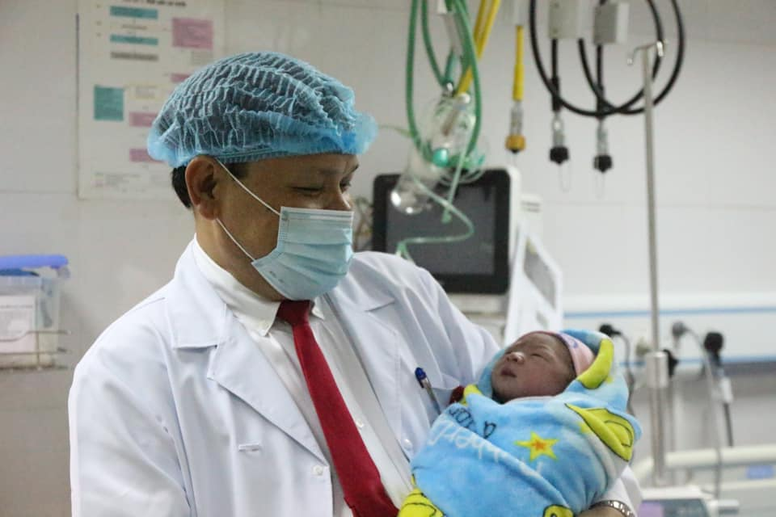
Exhausted while overworking in an epidemic
Happily welcome a new -born baby
1
2

Slide 5
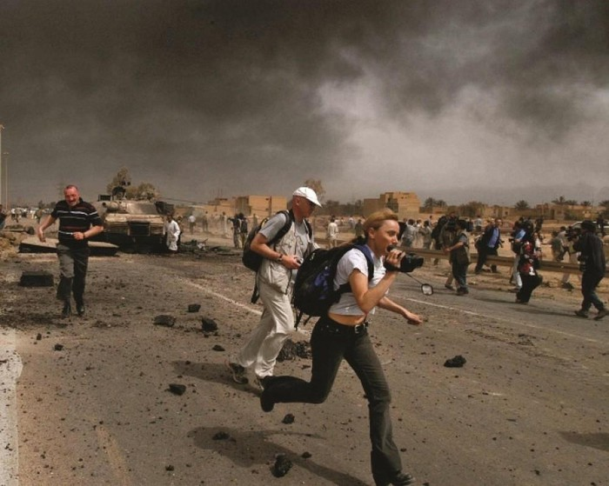
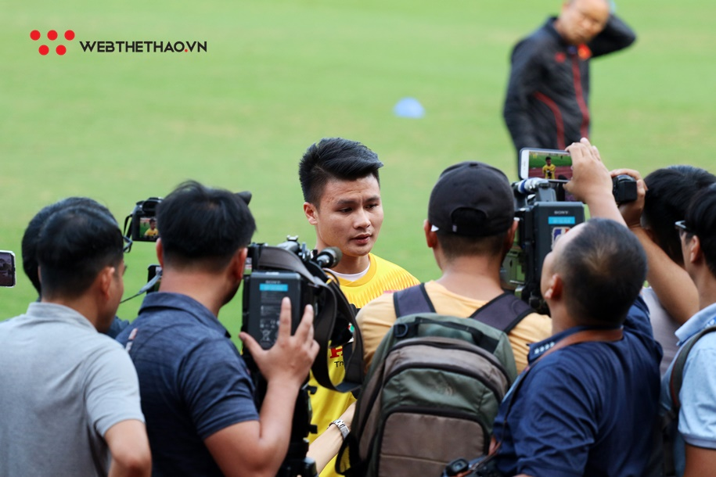
Go into battles to get news
Meet and interview famous people
1
2

Slide 6
What can you infer from the above pictures of careers?
→ Every career has its positive and negative points.

Slide 7
UNIT 9: CHOOSING A CAREER
Lesson 5: Listening
Positive and negative points of career

Slide 8
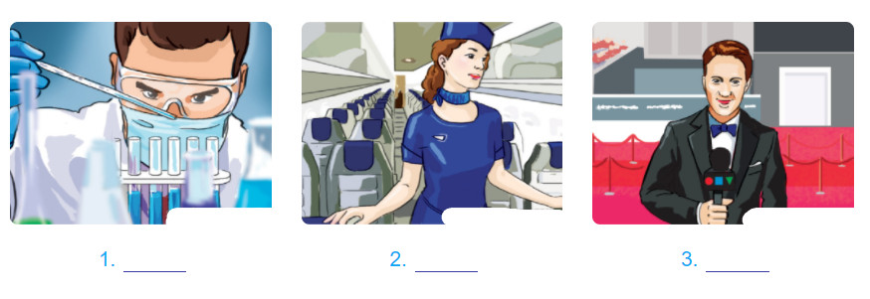
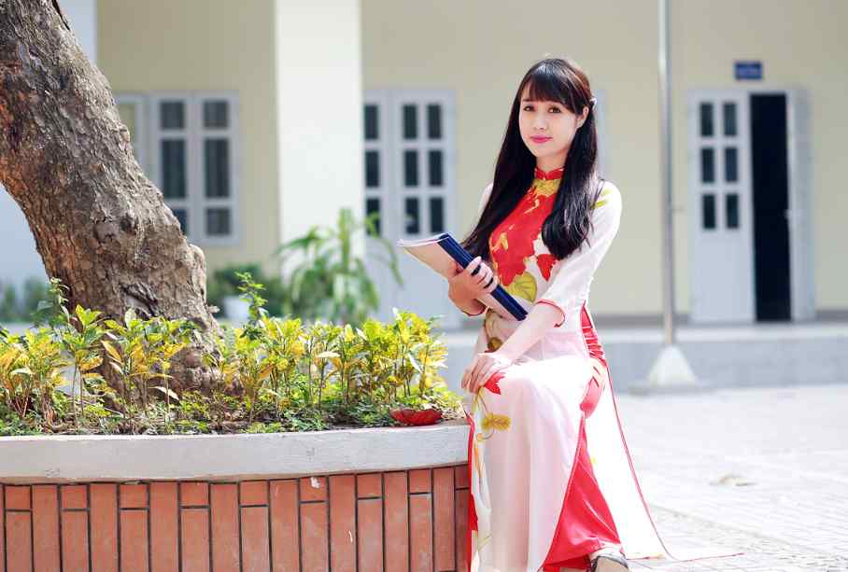
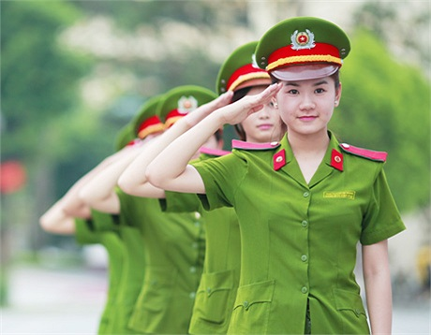
Task 1. What jobs do the people in the pictures do? Write down the job under each picture.
1. Medical researcher
2. Flight attendant
3. TV journalist
4. Doctor
4________
5. Teacher
5________
6. Police officer
6________

Slide 9
Vocabulary

Slide 10
Rewarding (adj)

Slide 11
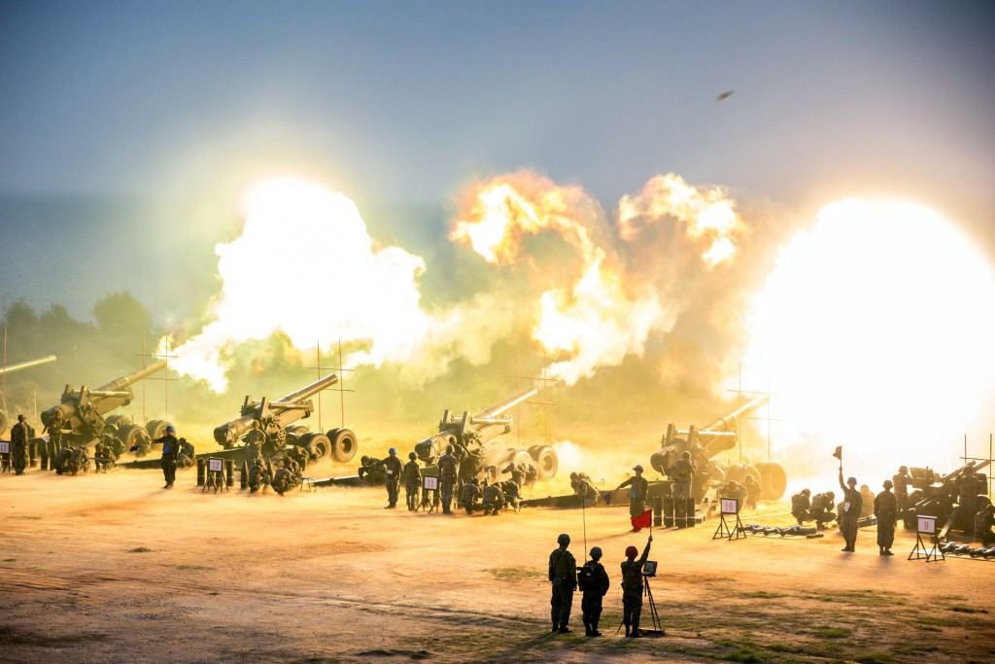
Battle (n)

Slide 12
Tedious (adj)

Slide 13
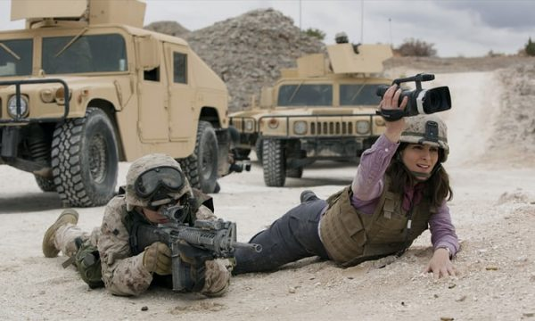
Downside (adj)

Slide 14
Checking vocabulary

Slide 15
Task 2. Match each word with its meaning.
Words | Meanings
1. Rewarding (n) | a. A negative aspect
2. Fascinating (adj) | b. Tiresome or boring
3. Battle (n) | c. Making you happy because you think it is useful or important
4. Tedious (adj) | d. A fight or struggle
5. Downside (n) | e. Extremely interesting and engaging

Slide 16
Task 3. Listen to an interview about the positive and negative points of the careers of three people. Match the career with each interviewee.
3
1
2

Slide 17
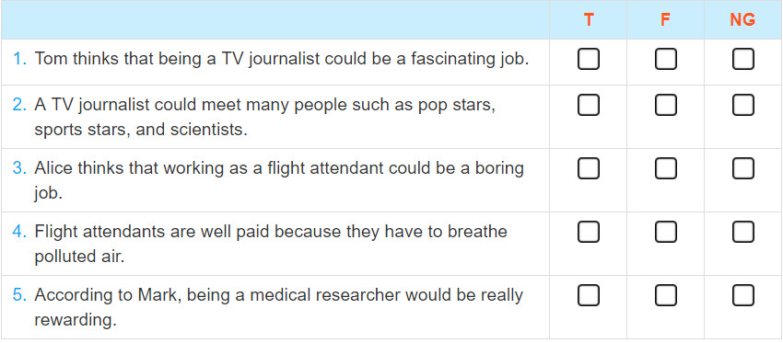
Task 4. Listen again and decide if the following statements are true (T), false (F), or not given (NG).
v
v
v
→ an interesting job
v
v

Slide 18
Task 5. Work in pairs. Choose one of the following 3 jobs to talk about. Discuss the question “What are the positive and negative points of the job?
Doctor
Teacher
Police officer
Sample dialogue
A: Do you want to become a doctor?
B: Yes, I do. Working as a doctor is a rewarding job because you can cure people and feel happy. What about you?
A: I don’t think that because a doctor has to work on a night shift and overwork when there are so many patients especially when there is an epidemic.

